Slide 1

Project Stage-I
on
“Diversified Investment Portfolio Experience
using Data Analytics”
Submitted to
VISHWAKARMA UNIVERSITY – Pune
In Partial fulfilment of the requirements for the award of degree
Bachelor of Technology (Computer Engineering)
Department of Computer Engineering
Faculty of Science and Technology
Under the Guidance of By
Prof. Tareek Pattewar Ashish Kumar (A02)
Mohd Salman Khan (B32)
Pratik Bhutada(A05)
Saleem Attar (A03)
S. Sanjith (A47)

Slide 2
What Is an Investment?
An asset or item acquired where intent is not to consume the good but rather to use it in the future to create wealth and generate income, an increase in the value of an asset over time.

Slide 3
What Is Portfolio Diversification?
Portfolio diversification is the process of investing your money in different asset classes and securities in order to minimize the overall risk of the portfolio.

Slide 4
Purpose of portfolio diversification
The fundamental purpose of portfolio diversification is to minimize the risk on your investments; specifically unsystematic risk.
Unsystematic risk also known as specific risk is risk that is related to a specific company or market segment. By diversifying your portfolio, this is the risk you hope to cut. This way, all your investments would not be uniformly affected in the same way by market events.

Slide 5
Major investments available in India:
Stocks
Cryptocurrency
Bonds
Real Estate
Fixed Diposits
Mutual Funds
Public Provident Fund (PPF)

Slide 6
Motivation
Diversification is a strategy that mixes a wide variety of investments within a portfolio.
Portfolio holdings can be diversified across asset classes and within classes, and also geographically
By investing in both domestic and foreign markets.
Diversification limits portfolio risk but can also mitigate performance, at least in the short term.

Slide 7
Stocks:
Also known as shares or equities. Buying an ownership stake in a publicly traded company.
Cryptocurrencies:
These are newest form of investment, digital currencies that don’t have any government backing operated through exchanges.

Slide 8
Mutual Funds
Pool of many investors’ money that is invested broadly in a number of companies. Mutual funds can be actively managed or passively managed.
Bonds:
Essentially lending money to an entity for interest payments until the agreed maturity period.

Slide 9
PREDICTION :
It comprises of the neural network trained using the data science techniques and algorithms.
Given data for stocks and crypto such as a day's open index, day's high, day's low, volume traded and the close values the predictor module will predict a index value for a given date.

Slide 10
What is the objectives of investment portfolio?
Creating wealth through capital appreciation
Optimizing the risk
Protecting your earnings from market volatility
Maximizing returns on investment
Offering flexibility within your investment portfolio
Improving the proficiency of your investments
Allocating available resources optimally

Slide 11
Our Approach:
Getting accurate and valid data.
Prepare data for training and testing.
Predict the prices.
Combining data of various assets.
Visualize the prediction results.
Showing the most precise results.

Slide 12
ARCHITECTURE OF APPLICATION
This project aims at predicting future prices by using various datasets in order to improve quality of output.
We are combining data mining time series analysis and machine learning algorithms such as Artificial Neural Network which is trained using algorithms.
Also, rich variety of on-line information and news make it an attractive resource from which to mine knowledge. Data mining and analysis of such financial information can aid market predictions.

Slide 13
BENEFITS OF THE TOOL :
Data mining techniques are effective for forecasting future by applying various algorithms over data.
Help traders/investers by providing supportive information such as the future market direction.
Provide the research of the market development a new thought.
Financial analysts can use this prediction model to take decision by observing market behaviour.

Slide 14
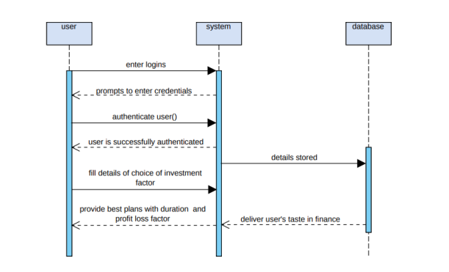
Sequence Diagram:

Slide 15

Stocks
Crypto
Others
Different algorithms depending on the nature
Bonds
FDs
Comparisons
Final Prediction

Slide 16
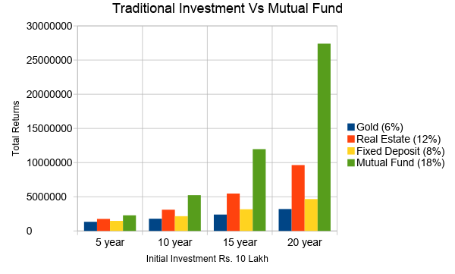
Comparison :

Slide 17
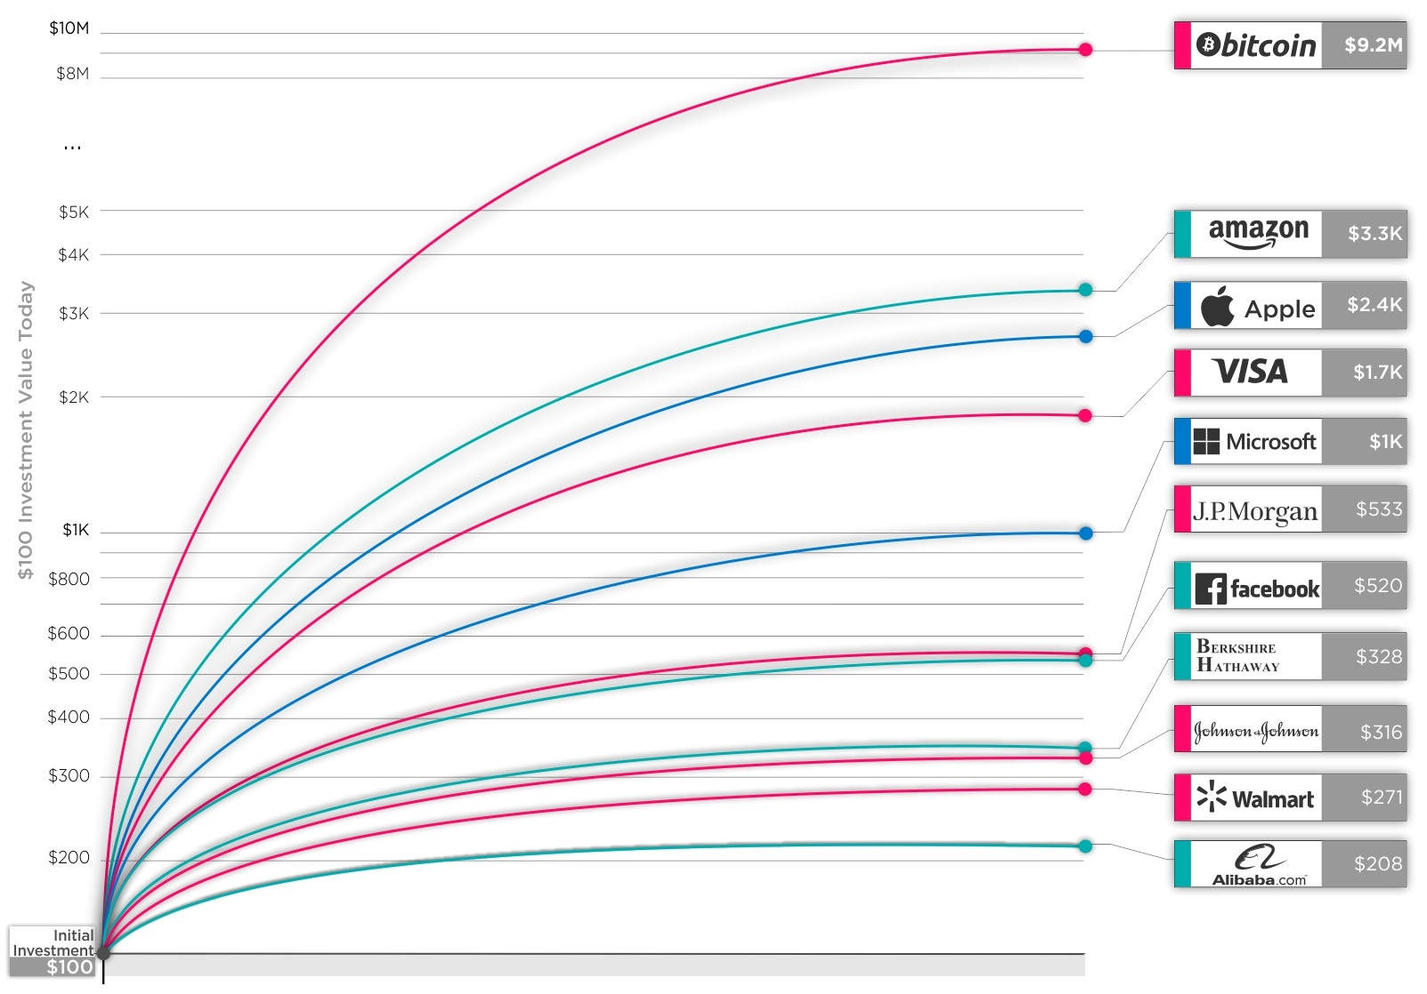
Investment in Companies for 10 years:

Slide 18
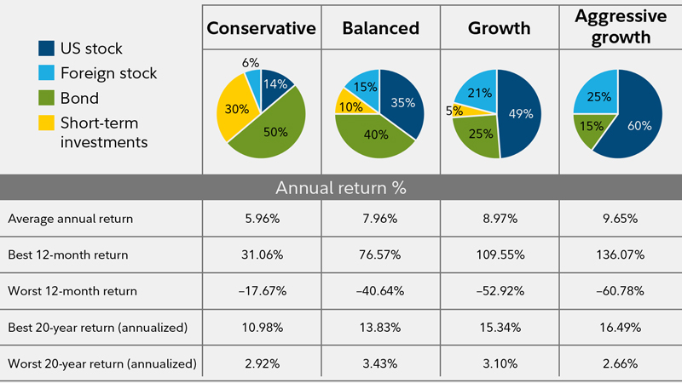
Portfolio Diversification:

Slide 19
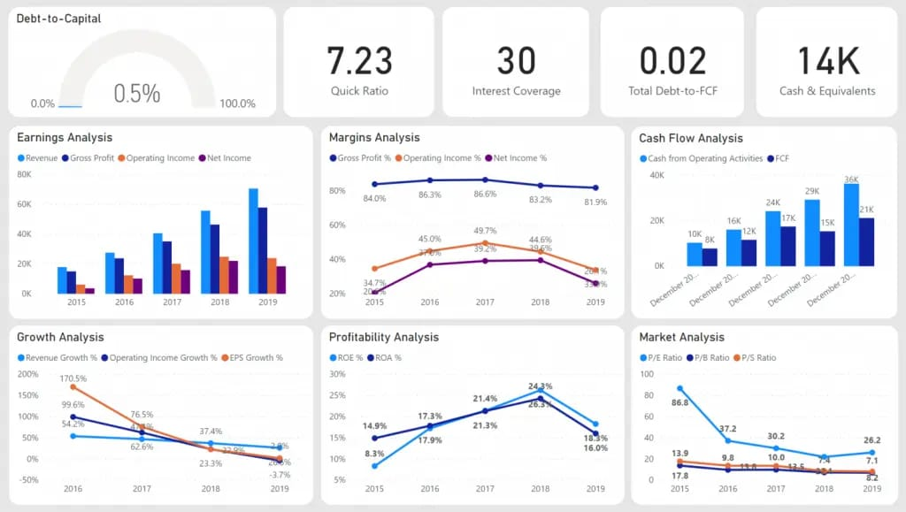
Analysis of Different Aspects:

Slide 20
Data Sources For Different Investments Portfolio

Slide 21
Stock
Websites :
MSN India : www.msn.com
Alpha Vantage : www.alphavantage.com
Applications :
Groww
Upstox
5paisa

Slide 22
Cryptocurrency
Websites:
www.coinmarketcap.com
www.prices.org
www.dogecoin.com
Applications :
Coinbase
Binance
WazirX

Slide 23
Mutual Fund
Webistes :
AMFI
www.mutualfundindia.com
Applications :
Groww
Paytm money

Slide 24
Fixed Deposit
Bank / Company :
Mahindra Finance
Axis Bank
Punjab Bank
Yes Bank
Canara Bank

Slide 25
National Pension System
Website :
Official government site : www.indiapost.gov.in
NPS Trust : enps.nsdl.com

Slide 26
THANK YOU

